Slide 1
Lesson 8

Slide 2
Quick summary

Slide 3
Story So Far...
Learning
(Change in behavior due to regularities in the environment)
Effects of Regularities in One stimulus
(e.g., Habituation)

Slide 4
Effects of Regularities in One stimulus
(e.g., Habituation)
Stimulus
Response

Slide 5
Story So Far...
Learning
(Change in behavior due to regularities in the environment)
Effects of Regularities in One stimulus
(e.g., Habituation)
Effects of Regularities in Two Stimuli
(e.g., Classical Conditioning)
Environmental Moderators
Sokolov, Bradley, Solomon
Mental Mediators
Chapter 1

Slide 6
Effects of Regularities in Two Stimuli
(e.g., Classical Conditioning)
Conditioned Stimulus
Conditioned Response
Unconditioned Stimulus

Slide 7
Story So Far...
Learning
(Change in behavior due to regularities in the environment)
Effects of Regularities in One stimulus
(e.g., Habituation)
Effects of Regularities in Two Stimuli
(e.g., Classical Conditioning)
Effects of Regularities in Stimuli & Responses (e.g., Operant Conditioning)
Environmental Moderators
Environmental Moderators
Sokolov, Bradley, Solomon
Mental Mediators
Associative (S-R, S-S) and Propositional Models
Mental Mediators
Chapter 1
Chapter 2

Slide 8
Effects of Regularities Between Stimuli & Responses
(e.g., Operant Conditioning)
Response (R)
Stimulus (Sr)

Slide 9
Story So Far...
Learning
(Change in behavior due to regularities in the environment)
Effects of Regularities in One stimulus
(e.g., Habituation)
Effects of Regularities in Two Stimuli
(e.g., Classical Conditioning)
Effects of Regularities in Stimuli & Responses (e.g., Operant Conditioning)
Complex learning effects
Environmental Moderators
Environmental Moderators
Environmental Moderators
Environmental Moderators
Sokolov, Bradley, Solomon
Mental Mediators
Associative (S-R, S-S) and Propositional Models
Mental Mediators
Mental Mediators
Associative (S-R, Mowrer) & Propositional Models
Mental Mediators
Chapter 1
Chapter 2
Chapter 3
Chapter 4

Slide 10
Lesson 8

Slide 11
Overview III.1.2. Core aspects of OC procedure:
III.1.2.1. Nature of the relation:
(a) contingency more important than contiguity
(b) conditional contingency
(c) schedules of reinforcement
(d) indirect relations
III.1.2.2. Changes in the nature of the relation
(a) no relation followed by relation
(b) relation followed by no relation
(c) context dependent

Slide 12
II.1.2. Key aspects of the Operant Conditioning (OC) procedure
OC procedure = Specific Sd: Present R-Sr relation in certain way
=> What do we mean by ‘relation’? = core property
=> How to present and measure? = boundary condition
II.1.2.1. The nature of the relation.
(a) Contingency is more important than contiguity
- degree of contingency R-Sr: p(Sr/R) - p(Sr/~R)
e.g. Hammond (1980):
* no effect if p(Sr/R) - p(Sr/~R) = 0
effect if p(Sr/R) - p(Sr/~R) = 0.05
Notes:
Contingency is more important than contiguity Just as the contingency between a CS and a US is determined by the difference between the probabilities of the US given the CS [p(US/CS)] and the probabilities of the US given the absence of the CS [p(US/~CS)], the contingency between an R and a Sr is determined by the difference between the probabilities of the Sr given that the R was posed [p(Sr/R)] and the probabilities of the Sr when R was not performed [p(Sr/~R)]. Operant conditioning strongly depends on the degree to which p(Sr/R) differs from p(Sr/~R).
The fact that animals are very sensitive to the degree of contingency between an R and a Sr is evident from a study by Hammond (1980) in rats. The duration of the experimental session was artificially divided into periods of 1 second. Within each period, the rat could either press the lever or not, obtaining food (Sr) with a probability of 0.05. In other words, out of 20 responses, only one was rewarded. However, food was never administered when the rat did not press the lever, so p(Sr/R) = 0.05 and p(Sr/~R) = 0.00.
12
Contingency is more important than contiguity. Just as the contingency between a CS and a US is determined by the difference between the probabilities of the US given the CS [p(US/CS)] and the probabilities of the US given the absence of the CS [p(US/~CS)], the contingency between an R and a Sr is determined by the difference between the probabilities of the Sr given that the R was emitted [p(Sr/R)] and the probabilities of the Sr when R was not emitted [p(Sr/~R)]. Operant conditioning strongly depends on the degree to which p(Sr/R) differs from p(Sr/~R).
The fact that animals are very sensitive to the degree of contingency between an R and a Sr is evident from a study by Hammond (1980) in rats. The duration of the experimental session was artificially divided into periods of 1 second. Within each period, the rat could either press the lever or not, obtaining food (Sr) with a probability of 0.05. In other words, out of 20 responses, only one was reinforced. However, food was never administered when the rat did not press the lever, so p(Sr/R) = 0.05 and p(Sr/~R) = 0.00.

Slide 13
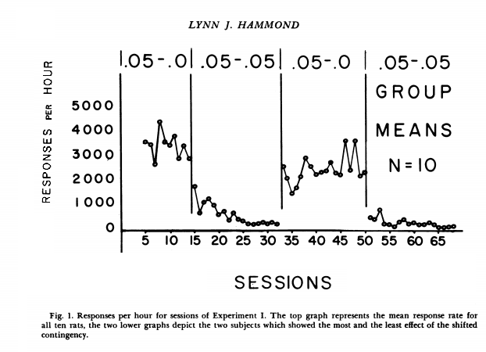
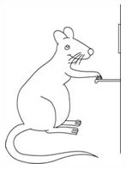
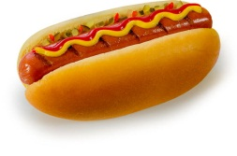
Contingency
No Contingency
Notes:
Thus, there was a positive contingency, although minimal, between lever pressing and obtaining food. Under these conditions, the frequency of R still increased. However, when Hammond set the probability of food without a response equal to 0.05 (in other words) once p(Sr/R) = p(Sr/~R) the rats stopped pressing the lever. It was as if they 'understood' that food was administered equally often. This shows that the frequency of behavior depends on the nature of the relationship between an R and Sr (namely, the contingency between behavior and consequences).
13
Thus, there was a positive contingency, although minimal, between lever pressing and obtaining food. Under these conditions, the frequency of R still increased. However, when Hammond set the probability of food without a response equal to 0.05 (in other words) once p(Sr/R) = p(Sr/~R) the rats stopped pressing the lever. It was as if they 'understood' that food was administered equally often. This shows that the frequency of behavior depends on the nature of the relationship between an R and Sr (namely, the contingency between behavior and consequences).

Slide 14
Four different types of contingencies
R-Sr Contingency
Valence Sr
Positive
# 1
# 2
Positive
Negative
R
Sr present
Reinforcement
Punishment
Negative
# 3
# 4
Positive
Negative
R
Sr absent
Punishment
Reinforcement
Escape (stop Sr) or avoidance (reduction in chance of Sr)
Notes:
If the Sr is a positive stimulus, then positive contingency between the R and the Sr will lead to an increase in frequency of behavior (reinforcement as effect) while negative contingency between R and Sr leads to a decrease in frequency of behavior (punishment as effect).
When Sr is a negative stimulus, a positive relationship between R and Sr will lead to punishment while a negative relationship between R and Sr will lead to reinforcement.
Again, we see here the evolutionary principle of "survival of the fittest" but at the level of the behavior of one particular organism rather than at the level of the behavior or traits of organisms across generations.
When there is a negative relationship between an R and a Sr, there are two ways in which R can reduce the probability of the Sr.
The first way is that Sr is present and R leads to Sr stopping. An R that causes a negative Sr to stop is called an escape behavior.
The second way is that an R reduces the probability that the Sr will occur. An R that is linked to a reduction in the probability that a negative Sr will occur is called an avoidance behavior. Escape and avoidance behaviors are very important in daily life and clinical practice. Through operant conditioning procedures one can study these behaviors in detail.
14
If the Sr is a positive stimulus, then the positive contingency between the R and the Sr will lead to an increase in frequency of behavior (reinforcement as an effect) while a negative contingency between R and Sr will lead to a decrease in frequency of behavior (punishment as an effect).
When the Sr is a negative stimulus, a positive relationship between R and Sr will lead to punishment while a negative relationship between R and Sr will lead to reinforcement.
When there is a negative relationship between an R and a Sr, there are two ways in which R can reduce the probability of the Sr.
The first way is that Sr is present and R leads to the Sr stopping. An R that causes a negative Sr to stop is called an escape behavior.
The second way is that an R reduces the probability that the Sr will occur. An R that is related to a reduction in the probability that a negative Sr will occur is called an avoidance behavior. Escape and avoidance behaviors are very important in daily life and the clinical context. Through operant conditioning procedures one can study these behaviors in detail.

Slide 15
(b) Conditional contingency
Group 1
*Phase 1:
*Phase 2:
Group 2 *Phase 1:
*Phase 2:
Notes:
Some findings show that conditional contingency is also as important for operant conditioning as it is for classical conditioning.
St. Claire-Smith (1979), for example, studied rats that had been taught to push a lever to get food. At a certain point the pushing was no longer followed by food but by a small electric shock. This reduced the frequency of lever pushing. A second group of rats was given exactly the same procedure, but they also learned beforehand that a light was always followed by the small electric shock. This light was also offered between pushing the handle and offering the electric shock.
In the second group, the decrease in the frequency of lever pushing was much less pronounced. It seems as if the contingency between light and shock interferes with learning the R-shock relation. In procedural terms there is an effect of conditional contingency: Pushing the lever does not affect the probability of shock in those situations where there is a light. The probability of shock is as high when the light is present alone (A+) than when both the light and lever pressing are present (AX+; where A=light and X=lever pressing). Thus, this finding is the equivalent of blocking in classical conditioning.
15
Some findings show that conditional contingency is also as important for operant conditioning as it is for classical conditioning.
St. Claire-Smith (1979), for example, studied rats that had been taught to push a lever to get food. At a certain point the pushing was no longer followed by food but by a small electric shock. This reduced the frequency of lever pushing. A second group of rats was given exactly the same procedure, but they also learned beforehand that a light was always followed by the small electric shock. This light was also presented between pushing the handle and presentation of the electric shock.

Slide 16
Freq R
R+Light - shock
R-shock
Phase 1
Phase 2
Notes:
In the second group, the decrease in the frequency of lever pushing was much less pronounced. It seems as if the contingency between light and shock interfered with learning the R-shock relation.
In procedural terms there is an effect of conditional contingency: Pushing the lever does not impact the probability of shock in those situations where there is a light. The probability of shock is as high when the light is present alone (A+) than when both the light and lever pressing are present (AX+; where A=light and X=lever pressing). This finding is the equivalent of blocking in classical conditioning.

Slide 17
Suppose there is a negative contingency between an R and a negative Sr. In this case the frequency
of R...
Notes:
🍐 This is a Pear Deck Multiple Choice Slide. Your current options are: A: Increase, B: Decrease, C: Remain unchanged, D: Decline first and then increase,
🍐 To edit the type of question or choices, go back to the "Ask Students a Question" in the Pear Deck sidebar.

Slide 18
Suppose there is a positive contingency between an R and a negative Sr. In this case the frequency
of R...
Notes:
🍐 This is a Pear Deck Multiple Choice Slide. Your current options are: A: Increase, B: Decrease, C: Remain unchanged, D: Decline first and then increase ,
🍐 To edit the type of question or choices, go back to the "Ask Students a Question" in the Pear Deck sidebar.

Slide 19
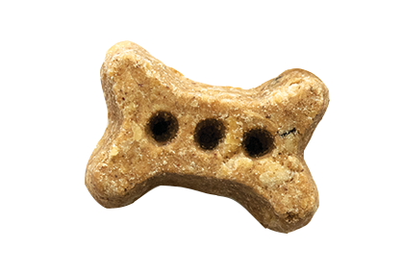
Overview: Impact core properties (i.e., nature of relation).
(a) Contingency
(b) Conditional contingency
(c) Schedules of reinforcement
Continuous reinforcement: R always followed by Sr
Partial reinforcement: R sometimes followed by Sr
- four types of partial reinforcement
Notes:
When an R is always followed by an Sr, this is called continuous reinforcement.
In everyday life, however, it is often the case that a certain R is not always followed by a Sr. In such situations we speak of partial affirmation. When ratification is partial, one has to decide when an R is followed by a Sr and when it is not. Four different schemes can be followed:
Fixed ratio, variable ratio, fixed interval, and variable interval. These four types of schedules result from the intersection of two characteristics: A schedule can be fixed or variable, and the administration of the reinforcer can depend on the number of behaviors (work-based) or on the time interval since the most recent administration of the reinforcer (time-based).
19
When an R is always followed by an Sr, this is called continuous reinforcement.
In everyday life, however, it is often the case that a certain R is not always followed by a Sr. In such situations we speak of partial reinforcement. When reinforcement is partial, one has to decide when an R is followed by a Sr and when it is not. Four different schedules of reinorcement can be followed:
Fixed ratio, variable ratio, fixed interval, and variable interval. These four types of schedules result from the intersection of two characteristics: A schedule can be fixed or variable, and the administration of the reinforcer can depend on the number of behaviors (work-based) or on the time interval since the most recent administration of the reinforcer (time-based).

Slide 20
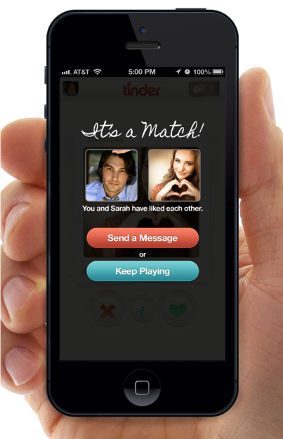
Operant Contingencies on Tinder
Sd
R
Sr
Notes:
1. In a fixed ratio (FR) scheme, a reinforcer is offered when a certain number of behaviours have been exhibited. For example, a fixed ratio of 1:4 (FR 1:4) means that a reinforcer is given every time the organism has engaged in a certain behaviour four times. Imagine that you are looking for someone on Tinder.
20

Slide 21
[Fixed ratio: "Work based" fixed ratio between quantity of Srs and quantity of Rs.
Example: FR 1:4: 1 match per 4 swipes
Notes:
1. In a fixed ratio (FR) scheme, a reinforcer is offered when a certain number of behaviours have been exhibited. For example, a fixed ratio of 1:4 (FR 1:4) means that a reinforcer is given every time the organism has engaged in a certain behaviour four times. Imagine that you are looking for someone on Tinder.
21
1. In a fixed ratio (FR) schedule, a reinforcer is delivered when a certain number of behaviours have been emitted. For example, a fixed ratio of 1:4 (FR 1:4) means that a reinforcer is delivered every time the organism has engaged in a certain behaviour four times. Imagine that you are looking for someone on Tinder.

Slide 22
[2] Variable ratio: Work-based variable ratio between quantity Srs and quantity Rs
Example: VR 1:5: sometimes 1 match for 3 swipes, sometimes 1 match for 7 swipes, ... but on average 1 match per 5 swipes
Notes:
2. In a variable ratio (VR) scheme, the administration of the reinforcer also depends on the number of times a behavior is stated, but the number of times a behavior must be stated varies from moment to moment.
For example, sometimes a reinforcer is given after setting seven behaviors, the next time after setting two behaviors, then again after twelve behaviors, and so on.
22
2. In a variable ratio (VR) scheme, the administration of the reinforcer also depends on the number of times a behavior is performed, but the number of times a behavior must be performed varies from moment to moment.
For example, sometimes a reinforcer is delivered after seven behaviors are performed, the next time after two behaviors, then again after twelve behaviors, and so on.

Slide 23
[3] Fixed interval: "Time-based“: first behavior is reinforced after a certain fixed interval
- Example: FI20: first R after predefined 20 min interval
Notes:
In a fixed interval (FI) scheme, you enforce the first behavior that follows a well-defined time interval. For example, in a FI 20 you will "match" with someone new the first time you swipe right after a 20 second interval has passed (e.g. because you have swiped too much before and now there is niemnd in the turn).
23
In a fixed interval (FI) scheme, you reinforce the first behavior that follows a well-defined time interval. For example, in a FI 20 you will "match" with someone new the first time you swipe right after a 20 second interval has passed (e.g. because you have swiped too much before and now there is no one available on the app).

Slide 24
[4] Variable interval: "Time based“: first behavior is reinforced after a variable interval
Example: VI60: sometimes first R after 40 s, sometimes after 120 s, but on average after 60 s
Notes:
Is a variable interval (VI) scheme. Here the reinforcer is offered after the first behavior that follows a variable interval. Suppose you swipe right and sometimes you match someone after 40 seconds, at other times after 120 seconds, but the average interval between right swiping and finding a match is 60 seconds.
24
Is a variable interval (VI) scheme. Here the reinforcer is delivered after the first behavior that follows a variable interval. Suppose you swipe right and sometimes you match someone after 40 seconds, at other times after 120 seconds, but the average interval between right swiping and finding a match is 60 seconds.

Slide 25
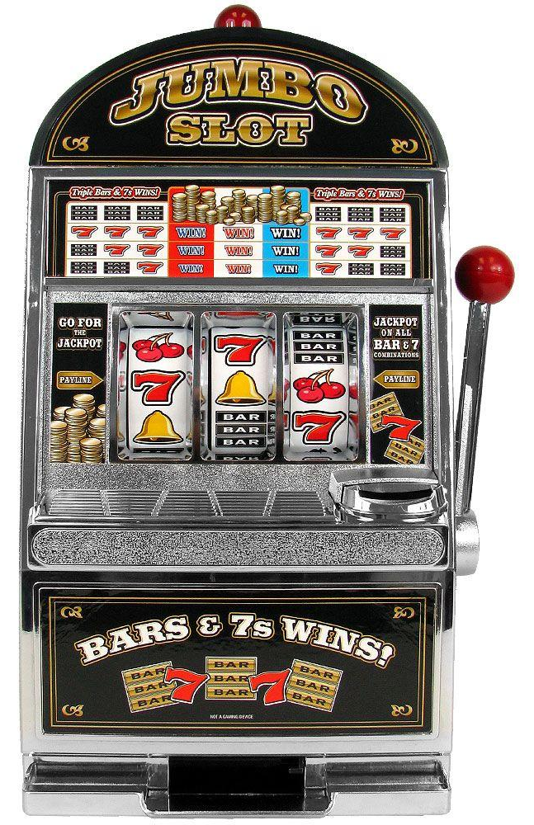
Computer games
Casinos
Obedience training

Slide 26
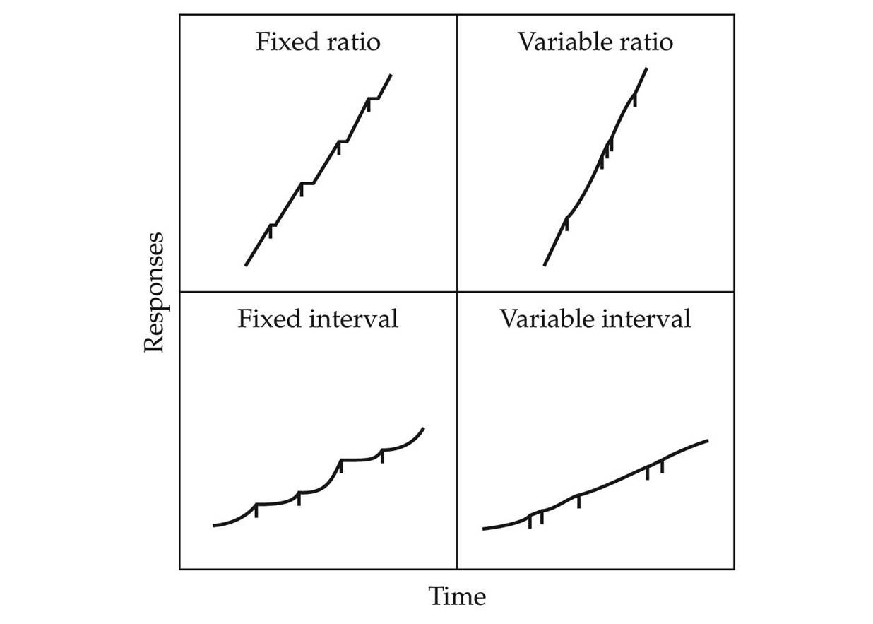
- Influence of reinforcement schedules on behavior (see youtube schedules of reinforcement)
Variable more stable behavior (because more uncertainty?)
Ratio schedules more Rs and more aversive (OC as glasses)
Notes:
We now know that these schedules lead to different kinds of behavior. For example, variable schedules result in much more regular behavior than fixed schedules. We can see this in the cumulative frequency curves. There is often a jumpy gradient of behavior in fixed schedules while there is almost a straight-line gradient in variable schedules.
M.A.W. The frequency with which a behavior is exhibited is spectacularly influenced by the nature of the relationship between the behavior and the environment. A person working on a fixed Tinder ratio will certainly take more breaks after each reinforcement while a person working on a variable ratio will take much less breaks.
26
We now know that these schedules lead to different kinds of behavior. For example, variable schedules result in much more regular behavior than fixed schedules. We can see this in the cumulative frequency curves. There is often a jumpy gradient of behavior in fixed schedules while there is almost a straight-line gradient in variable schedules.
In other words: the frequency with which a behavior is emitted is spectacularly influenced by the nature of the relationship between the behavior and the environment. A person working on a fixed Tinder ratio will certainly take more breaks after each reinforcement while a person working on a variable ratio will take far fewer breaks.

Slide 27
Q1: A child is rewarded once a week (on Saturday) if their room is tidied up
Notes:
🍐 This is a Pear Deck Multiple Choice Slide. Your current options are: A: Fixed Ratio Schedule, B: Fixed Interval Schedule, C: Variable Ratio Schedule, D: Variable Interval Schedule,
🍐 To edit the type of question or choices, go back to the "Ask Students a Question" in the Pear Deck sidebar.
Q1: (Fixed Interval schedules - produce an accelerated rate of response as the time of reinforcement approaches)

Slide 28
Q2: Every time you put money in the vending machine, you receive your candy bar.
Notes:
🍐 This is a Pear Deck Multiple Choice Slide. Your current options are: A: Fixed Ratio Schedule, B: Fixed Interval Schedule, C: Variable Ratio Schedule, D: Variable Interval Schedule,
🍐 To edit the type of question or choices, go back to the "Ask Students a Question" in the Pear Deck sidebar.
Q2: (Fixed Ratio 1 - schedule --- same as continuous reinforcement!!!)

Slide 29
Q3: Waiting for an elevator to be taken is reinforced according to
Notes:
🍐 This is a Pear Deck Multiple Choice Slide. Your current options are: A: Fixed Ratio Schedule, B: Fixed Interval Schedule, C: Variable Ratio Schedule, D: Variable Interval Schedule,
🍐 To edit the type of question or choices, go back to the "Ask Students a Question" in the Pear Deck sidebar.
Q3: (Variable Interval 2 hour Schedule)

Slide 30
Q4: You have to email your friend Jietske about 3 times before she emails you back. After your third email, however, she usually starts responding.
Notes:
🍐 This is a Pear Deck Multiple Choice Slide. Your current options are: A: Fixed Ratio Schedule, B: Fixed Interval Schedule, C: Variable Ratio Schedule, D: Variable Interval Schedule,
🍐 To edit the type of question or choices, go back to the "Ask Students a Question" in the Pear Deck sidebar.
Q4: Variable ratio schedule (1:3)

Slide 31
Notes:
🍐 This is a Pear Deck Multiple Choice Slide. Your current options are: A: I'm ready to continue!, B: Wait a minute. I'm not ready!
🍐 To edit the type of question or choices, go back to the "Ask Students a Question" in the Pear Deck sidebar.

Slide 32
- Influence of reinforcement schedules on choice behavior
* Choice: If two behaviors are possible, which behavior does one choose?
=> Answer learning psychology: depends on Sr following behavior and schedules relating behaviors to Sr
Vs.
Notes:
Matching law has led to much research. This type of research has even developed into a separate discipline called "behavioural economics". On the basis of this research, certain variables were added to the matching law (e.g. the size of the stimulants and the time interval of administration). Without going into the mathematical expression of the matching law, there are impressive findings on the heuristic value of the law. The conclusions of this research have often been applied in the context of drug use.
To better illustrate the complexity of choice behavior, we need to go one step further. Take the experiment of Rachlin and Green. They used a concurrent-chain procedure, and this procedure has become a paradigm that is often used to study self-control.
32
Schemes of reinforcement influence not only the frequency of behaviour but also our choice behaviours (i.e. which behaviour one will choose when there are several options). Choice behavior is very important and every organism must constantly choose what to do. Each stimulus is associated with a particular reinforcement history. If this is the case, then we can ask to what extent this reinforcement history can be used to predict what my choice will be here and now.

Slide 33
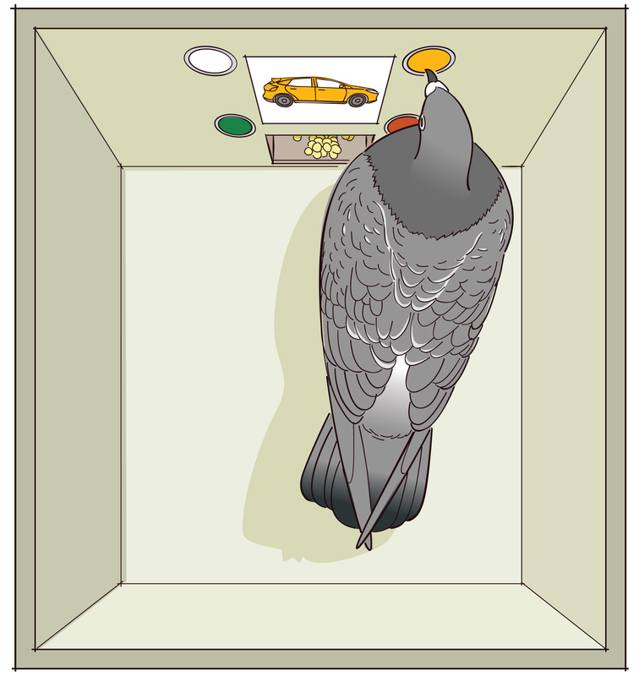
* Procedures:
° T-maze (note: all is choose)
° Concurrent schedules (in Skinner box)
- 2 keys (so 2 Rs possible)
- 2 different R-Sr schedules are present simultaneously (concurrent)
(e.g. A:VI-30; B:VI-10)
Notes:
Matching law has led to much research. This type of research has even developed into a separate discipline called "behavioural economics". On the basis of this research, certain variables were added to the matching law (e.g. the size of the stimulants and the time interval of administration). Without going into the mathematical expression of the matching law, there are impressive findings on the heuristic value of the law. The conclusions of this research have often been applied in the context of drug use.
To better illustrate the complexity of choice behavior, we need to go one step further. Take the experiment of Rachlin and Green. They used a concurrent-chain procedure, and this procedure has become a paradigm that is often used to study self-control.
33
Experimental procedures were developed to answer this complex question. Historically, it has already begun with the study of a laboratory animal in a T-maze, where the choice was made to walk left or right. Tolman (1938) proposed that all behavior of humans and animals is a choice between alternatives, and that the study of the behavior of a rat in a T-maze may provide a first step towards a better understanding. The pushing behavior of the rat (or the pecking behavior of the pigeon) in the Skinner-box is also choice behavior: there is always the choice between pushing (or pecking) or 'doing something else'.
To make choice behavior more explicit, consider a typical example of pigeons in a Skinner box. Instead of one pressure key, there were two pressure keys, each connected to a different reinforcement schedule. Pressing key (A) leads to feeding according to a VI-30 sec schedule and this leads to stable and high frequency behaviour. At that moment a second key (B) is introduced: pressing this key leads to food according to a VI-10 sec schedule. After a while the pigeon loses interest in the first key (A) and pecks relatively more on key (B).
This example shows that a certain behavior is not only influenced by the reinforcement history, but also by the concurrent behavioral alternatives available in another schedule. In this context, one speaks of 'concurrent schedules'.

Slide 34
Procedural theory: Matching law
° Ra ra
Ra + Rb ra + rb
R= rate of responding
r = rate of reinforcement
=
Notes:
Now if we give the test animals a choice between a small and large reward they all choose the larger of the two. If I give you a choice between 1 Euro or 2 Euro you almost always choose the 2 Euro. If the test animals are given a choice between an immediate small reward and a delayed larger reward, they usually choose the immediate reward.
In the study of Rachlin and Green the animals were confronted with two pressure keys. Pressing the first key led to a small reward and pressing the second key led to a larger reward. After pressing a key there was a waiting period, but this period was longer for the large than for the small reward. In this case there was a preference for the larger reward despite the fact that the animals had to wait longer than for the small reward.
This and similar research has given us a better understanding of what we mean by self-control and how this can possibly lead to the learning of self-control (e.g. impulsive or hyperactive children). It is also relevant to our understanding of addictions, something directly related to self-control. For example, smokers often choose the immediate small reward (smoking a cigarette now) and thereby reduce the likelihood of a delayed large reward (longer and healthier life). There is also a clear link with economics.
34
When two behaviors are simultaneously reinforced according to a variable interval schedule, there is a lawful relationship between the relative frequency with which one of the alternative behaviors is stated and the number of reinforcers associated with each of the alternatives. This is the core of the matching law (Herrnstein, 1970; de Villiers, 1977):
On the left side of the equation is the frequency with which one of the behavioral alternatives (A) is emitted. By "relative" we mean the frequency of A relative to the frequency of both behaviors. If there is no specific preference for A or B, then this ratio will be equal to .5. Preference for A or B leads to a ratio greater or less than .50. On the right (rA and rB ) is the relative reinforcing value of each response alternative. The Matching Law points out that there is usually a perfect match between the two ratios.

Slide 35
What would you choose?
Notes:
Now if we give the test animals a choice between a small and large reward they all choose the larger of the two. If I give you a choice between 1 Euro or 2 Euro you almost always choose the 2 Euro. If the test animals are given a choice between an immediate small reward and a delayed larger reward, they usually choose the immediate reward.
In the study of Rachlin and Green the animals were confronted with two pressure keys. Pressing the first key led to a small reward and pressing the second key led to a larger reward. After pressing a key there was a waiting period, but this period was longer for the large than for the small reward. In this case there was a preference for the larger reward despite the fact that the animals had to wait longer than for the small reward.
This and similar research has given us a better understanding of what we mean by self-control and how this can possibly lead to the learning of self-control (e.g. impulsive or hyperactive children). It is also relevant to our understanding of addictions, something directly related to self-control. For example, smokers often choose the immediate small reward (smoking a cigarette now) and thereby reduce the likelihood of a delayed large reward (longer and healthier life). There is also a clear link with economics.
35
To illustrate Matching Law, imagine you're at home with a friend. There are two alternative options on the television: Game of Thrones and Temptation Island. And each option is associated with a certain reinforcing value: There are approximately 6 reinforcing moments per hour if you watch Game of Thrones and only two per hour if you watch Temptation Island.

Slide 36
Procedural theory: Matching law
° Ra 6
Ra + Rb 6 + 2
R= rate of responding
r = rate of reinforcement
=
°Example (VI only!!):
Temptation Island (A): VI 10 => per hour 6 Sr
How I Met Your Mother: (B): VI 30 => per hour 2 Sr
ra / ra + rb = 6/8 = .75 = ¾
Is law, even if it does not always hold (see also law of gravity)
Notes:
Now if we give the test animals a choice between a small and large reward they all choose the larger of the two. If I give you a choice between 1 Euro or 2 Euro you almost always choose the 2 Euro. If the test animals are given a choice between an immediate small reward and a delayed larger reward, they usually choose the immediate reward.
In the study of Rachlin and Green the animals were confronted with two pressure keys. Pressing the first key led to a small reward and pressing the second key led to a larger reward. After pressing a key there was a waiting period, but this period was longer for the large than for the small reward. In this case there was a preference for the larger reward despite the fact that the animals had to wait longer than for the small reward.
This and similar research has given us a better understanding of what we mean by self-control and how this can possibly lead to the learning of self-control (e.g. impulsive or hyperactive children). It is also relevant to our understanding of addictions, something directly related to self-control. For example, smokers often choose the immediate small reward (smoking a cigarette now) and thereby reduce the likelihood of a delayed large reward (longer and healthier life). There is also a clear link with economics.
36
Based on the matching law, you can now predict how over the hour the choice behavior will proceed. With these reinforcement schedules, rA (Game of Thrones) equals at most 6 reinforcers per hour and rB (Temptation Island) equals 2. Therefore, rA / (rA + rB) = 6/8 = .75. So you can predict that - basically – you will spend ¾ of your time watching Game of Thrones and ¼ watching Temptation Island.

Slide 37
Extensions of matching law
not only " r " but also amount of Sr; importance of Sr; time between R and Sr
important model for human choices: Behavioral economics
Example of an important additional factor: immediacy of reinforcement: Competitor-chain (Rachlin & Green)
Notes:
Behavior can also be influenced by indirect links between the behavior and stimuli in the environment. Take the idea of secondary reinforcement. Early in the history of learning psychology, Hull made the distinction between primary and secondary exciters. Primary reinforcers are stimuli that have a biological need (e.g., food, drink). Secondary reinforcers are stimuli that (1) occur together with primary reinforcers or (2) can be used to obtain other reinforcers. We now know that behaviour can change as a result of the influence of a secondary reinforcer. So they are evidence for the influence of indirect links: an R is linked to a neutral Sr that only has influence because that Sr is linked to other (primary) Sr.
Reinforcement by stimuli associated with primary reinforcers is also called conditioned reinforcement. Suppose a tone is followed by food. We now know that an animal learns to push a handle if this leads to the offering of the tone. In other words, the offering of the tone reinforces the pushing of the handle. The tone is not in itself an enabler but only because it used to be associated with a primary enabler. This is shown by the fact that the tone only reinforces lever pushing if it was previously associated with food.
A second form of secondary reinforcers are stimuli that can be used to obtain other reinforcers. These are called token reinforcers. Money is a good example. Any person will do many things to get money. But money by itself has no biological value. It is effective as a reinforcer because it is associated with obtaining primary reinforcers. Token reinforcers, like other conditioned reinforcers, are associated with primary reinforcers. But the relationship between token exciters and primary exciters is special. Tokens can be used to obtain other exciters.
37
But note that the matching law is only valid under certain conditions. This law is only valid in variable interval schedules. In these schedules it is never certain at which moment the performance of a certain behavior is reinforced. If the two behaviors are reinforced according to a fixed ratio schedule, the organism will only choose the option that is most reinforced.

Slide 38
Question: what would you choose?
5 euros
50 euros
Notes:
🍐 This is a Pear Deck Multiple Choice Slide. Your current options are: A: 5 euros, B: 50 euros,
🍐 To edit the type of question or choices, go back to the "Ask Students a Question" in the Pear Deck sidebar.

Slide 39
Question: what would you choose?
5 euros (TODAY)
50 euros (March 2021)
Notes:
🍐 This is a Pear Deck Multiple Choice Slide. Your current options are: A: 5 euros (today), B: 50 euros (March 2021),
🍐 To edit the type of question or choices, go back to the "Ask Students a Question" in the Pear Deck sidebar.

Slide 40
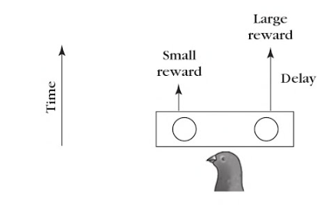
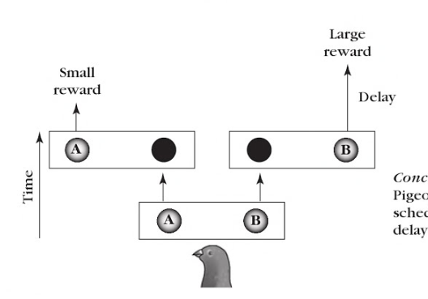
Concurrent chains: Self control
Relevance: ADHD, addiction, economics => unique framework for understanding many facets of human behavior
Notes:
So far, we have only discussed indirect connections between R and Srs. But indirect relations between an Sd and R can also have an influence on operant conditioning. This is shown in the study of Colwill and Rescorla with rats.
In a first stage, R1 (pressing a button) was followed by food (Sr1) when a light was on (Sd1). The same R1 was followed by sugar water (Sr2) when a tone was offered (Sd2). In the second phase, the rats learned that R2 (pushing a lever) was followed by food (Sr1) and that R3 (pulling a chain) was always followed by sugar water (Sr2).
In this second phase there were no Sds. In the test phase the rats had to choose between pushing the lever and pulling the chain. When given the choice during the presentation of the light, they chose lever pushing over chance. However, during the presentation of the tone they chose chain pulling. The Sd influenced R's choice despite the fact that the two never occurred together but were only indirectly linked through a particular Sr.
40
Now if we give the test animals a choice between a small and large reinforcer they all choose the larger of the two. If I give you a choice between 1 Euro or 2 Euro you almost always choose the 2 Euro. If the test animals are given a choice between an immediate small reinforcer and a delayed larger reinforcer, they usually choose the immediate reinforcer.
In the study of Rachlin and Green the animals were confronted with two keys. Pressing the first key led to a small reinforcer and pressing the second key led to a larger reinforcer. After pressing a key there was a waiting period, but this period was longer for the large than for the small reinforcer. In this case there was a preference for the larger reinforcer despite the fact that the animals had to wait longer than for the small reinforcer.
This and similar research has given us a better understanding of what we mean by self-control and how this can possibly lead to the learning of self-control (e.g. impulsive or hyperactive children). It is also relevant to our understanding of addiction, something directly related to self-control. For example, smokers often choose the immediate small reinforcer (smoking a cigarette now) and thereby reduce the likelihood of a delayed large reinforcer (longer and healthier life). There is also a clear link with economics.

Slide 42
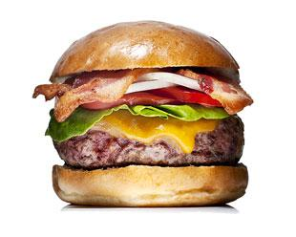
Indirect relation:
- Between R and Sr: Secondary reinforcement (Hull)
Primary Sr: meet primary need
Notes:
42
Behavior can also be influenced by indirect relationships between the behavior and stimuli in the environment. Take the idea of secondary reinforcement. Early in the history of learning psychology, Hull made the distinction between primary and secondary reinforcers. Primary reinforcers are stimuli that have a biological need (e.g., food, drink).

Slide 43
* Secondary Sr: 2 types:
° contingency with primary Sr
# is called conditioned reinforcement
# e.g., pressing lever for food
Notes:
43
Secondary reinforcers are stimuli that (1) occur together with primary reinforcers or (2) can be used to obtain other reinforcers. We now know that behavior can change as a result of the influence of a secondary reinforcer. So they are evidence for the influence of indirect relations: an R is related to a neutral Sr that only has influence because that Sr is linked to other (primary) Sr.
Reinforcement by stimuli associated with primary reinforcers is also called conditioned reinforcement. Suppose a tone is followed by food. We now know that an animal learns to push a handle if this leads to the offering of the tone. In other words, the offering of the tone reinforces the pushing of the handle. The tone is only a reinforcer because it was previously associated with a primary reinforcer. This is shown by the fact that the tone only reinforces lever pushing if it was previously associated with food.

Slide 44
can be exchanged for other Srs: Token
# e.g. money, drink tickets
# link + additional behaviour (trade-off)
# Token economy (eg, monkeys)
# very effective because can be exchanged for Sr who is important at the time
Notes:
44
Another type of secondary reinforcer is a stimulus that can be used to obtain additional reinforcers. These are called token reinforcers. Money is a good example. People will do many things to gain access to money. But money by itself has no biological value. It is effective as a reinforcer because it is associated with obtaining primary reinforcers. Token reinforcers, like other conditioned reinforcers, are associated with primary reinforcers. But the relationship between token reinforcers and primary reinforcers is special. Tokens can be used to obtain other reinforcers.

Slide 46
Question: What was the token reinforcer in the previous movie?
Notes:
🍐 This is a Pear Deck Multiple Choice Slide. Your current options are: A: The monkey, B: The small stone, C: The cucumber, D: The grapes,
🍐 To edit the type of question or choices, go back to the "Ask Students a Question" in the Pear Deck sidebar.

Slide 47
Question: Which option is (for mostly people) a typical example of a secondary reinforcer?
Notes:
🍐 This is a Pear Deck Multiple Choice Slide. Your current options are: A: money, B: food, C: sex, D: pain in the back,
🍐 To edit the type of question or choices, go back to the "Ask Students a Question" in the Pear Deck sidebar.

Slide 48
Q: Self-control studies have used...
Notes:
🍐 This is a Pear Deck Multiple Choice Slide. Your current options are: A: Concurrent chain procedures, B: Continuous reinforcement, C: Continuous punishment, D: Partial reinforcement,
🍐 To edit the type of question or choices, go back to the "Ask Students a Question" in the Pear Deck sidebar.

Slide 49
Indirect relationships between Sd and R
Phase 1:
Phase 2: No Sd
Test:
Notes:
E.g. take a situation where first an R or Sr was present alone. This inital experience with the R or Sr can influence subsequent learning of the relationship between the R and Sr.
A good example is learned helplessness. To better illustrate this, take the experiment of Seligman & Maier. Here, two groups of dogs were exposed to an experiment that was divided into two phases. In the first phase, an electric shock was administered to one group of dogs. This shock stopped when the dogs pressed a lever. The second group also received a shock but they could not do anything to escape it. So in this group there is a non-contiguous relationship between lever pushing and shock.
During a second phase, both groups must learn an avoidance behavior (jump from one side of the shuttle box to the other). This is learned by the first but not by the second group. These findings have led to new insights into depression. They also show that humans and other animals can learn not only that connections are present but also that connections are absent.
49
So far, we have only discussed indirect relations between R and Srs. But indirect relations between an Sd and R can also have an influence on operant conditioning. This is shown in the study of Colwill and Rescorla with rats.
In a first stage, R1 (pressing a button) was followed by food (Sr1) when a light was on (Sd1). The same R1 was followed by sugar water (Sr2) when a tone was presented (Sd2). In the second phase, the rats learned that R2 (pushing a lever) was followed by food (Sr1) and that R3 (pulling a chain) was always followed by sugar water (Sr2).
In this second phase there were no Sds. In the test phase the rats had to choose between pushing the lever and pulling the chain. When given the choice during the presentation of the light, they chose lever pushing over chance. However, during the presentation of the tone they chose chain pulling. The Sd influenced R's choice despite the fact that the two never occurred together but were only indirectly related through a specific Sr.

Slide 50
Overview III.1.2. Core aspects of OC procedure:
III.1.2.1. Nature of the relation:
(a) contingency more important than contiguity
(b) conditional contingency
(c) schedules of reinforcement
(d) indirect relations
III.1.2.2. Changes in the nature of the relation
(a) no relation followed by relation
(b) relation followed by no relation
(c) context dependent

Slide 51
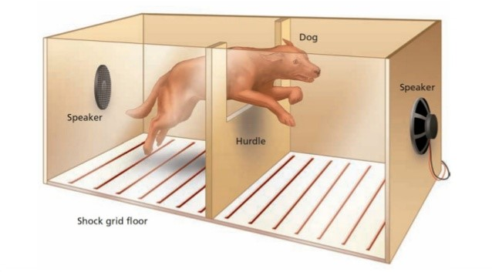
First no relation then relation
Phase 1
Phase 2
Group 1
Group 2
Notes:
Several explanations for this effect have been proposed. The first is the discrimination hypothesis. According to this hypothesis, the effect is due to the fact that the transition from reinforcement to extinction is much clearer when the reinforcement was continuous rather than partial. With CR, there is a clear difference because first a behavior was always reinforced and suddenly it was never reinforced again. With partial reinforcement, the behavior was only reinforced now and then. So it is (at the beginning of extinction not clear) whether the behavior is not rewarded because it will never be rewarded again (extinction) or because the behavior is only occasionally rewarded.
But research shows that this hypothesis is incorrect. Take the experiment by Theios and Jenkins. Here there were two groups exposed to three phases. In both groups, the transition from reinforcement to extinction (Phase 2 to 3) was equally clear because both groups received continuous reinforcement in Phase 2. Based on the discrimination hypothesis, we would predict that the frequency of behavior during extinction would decrease equally rapidly in both groups. However, in their experiment, extinction decayed faster in Group C than P. This could only be due to the fact that Group P (but not Group C) was exposed to a partial reinforcement scheme during the first phase.
51
E.g. Take a situation where first an R or Sr was present alone. This initial experience with the R or Sr can influence later learning of the relationship between the R and Sr.
A good example is learned helplessness. To better illustrate this, take the experiment of Seligman & Maier. Here, two groups of dogs were exposed to an experiment that was divided into two phases. In the first phase, an electric shock was administered to one group of dogs. This shock stopped when the dogs pressed a lever. The second group also gets a shock but they can't do anything to escape it. So in this group there is a non-contiguous relationship between lever pushing and shock.
During a second phase, both groups must learn an avoidance behavior (jump from one side of the shuttle box to the other). This is learned by the first but not by the second group. These findings have led to new insights into depression. They also show that humans and other animals can learn not only that connections are present but also that connections are absent.

Slide 53
Extinction
First relation, then no relation

Slide 54
First relation then no relation
Acquisition: Increase freq. R as R-Sr relationship
Extinction: Decrease freq. R as R-Sr relationship gone
Extinction burst (more + more variable)
=> functional for discovering new connections
Notes:
Another explanation is Amsel's frustration theory. According to this theory a crucial difference between CRF and PRF is that only during PRF one is confronted with the experience that a behavior for which they expect a reward is not rewarded.
According to Amsel, partial reinforcement offers the opportunity to learn to deal with the frustration of not rewarding behavior when the reward is expected. Group P have experience with the fact that an expected reward sometimes does not come. This group will therefore be more resistant to the frustration that occurs at the start of the extinction phase.
54
When an R-Sr relationship is present, it will lead to a change in behavior. This change is called acquisition. When the contingency between R and Sr is broken, the learned change in behavior will disappear again. This effect is called extinction.
Often (immediately after the start of the extinction procedure) there is a short period in which there is an increase in the frequency of R. This "extinction burst" is often followed by an increase in the variability of behavior.

Slide 55
Extinction Burst
Freq R
Partial reinforcement
Partial Reinforcement
Extinction Effect
Continuous reinforcement
R - Sr
R - No Sr
Notes:
Taking a break
55
Suppose a rat has learned that pushing a lever is followed by food and suddenly it does not. After the rat observes for the first time that pushing the lever does not lead to food, it will push the lever a few times quickly (extinction burst) and then it will push the lever in several new ways.
Eventually the animal will stop pushing the lever. Looking at this from a human perspective, it seems as if the rat wants to be sure that the behavior no longer has the desired effect. Note that extinction bursts and higher variability in behavior at the start of conditioning can be used to establish new behavior (e.g. shaping).
The degree of extinction is influenced by the nature of the initial relationship between the R and the Sr. E.g. The type of schedule of reinforcement is important here: continuous or partial reinforcement. If a certain behavior is always followed by a reinforcer during a first phase (CRF) and in a second phase the same behavior is no longer followed by the reinforcer (extinction), then the frequency of the behavior will decrease quite rapidly.
When a behavior is partially reinforced during the first phase, the behavior will disappear less quickly during extinction. The fact that extinction is less effective after partial than after consistent reinforcement is called the partial-reinforcement extinction effect.

Slide 56
Q: The functional phenomenon of extinction shows that:
Notes:
🍐 This is a Pear Deck Multiple Choice Slide. Your current options are: A: Conditioned changes in behavior disappear when an R was not followed by a Sr, B: The strength of the R-Sr contingency decreases when an R was followed by a Sr, C: The strength of R-Sr associations in memory decreases when an R was followed by a Sr, D: The effect of an R-Sr association may spontaneously extinguish,
🍐 To edit the type of question or choices, go back to the "Ask Students a Question" in the Pear Deck sidebar.

Slide 57
Notes:
🍐 This is a Pear Deck Multiple Choice Slide. Your current options are: A: I'm ready to continue!, B: Wait a minute. I'm not ready!
🍐 To edit the type of question or choices, go back to the "Ask Students a Question" in the Pear Deck sidebar.

Slide 58
Overview III.1.2. Core aspects of OC procedure:
III.1.2.1. Nature of the relation:
(a) contingency more important than contiguity
(b) conditional contingency
(c) schedules of reinforcement
(d) indirect relations
III.1.2.2. Changes in the nature of the relation
(a) no relation followed by relation
(b) relation followed by no relation
(c) context dependent
Notes:
Research shows that only humans can show arbitrary applicable relational responding. The phenomenon of stimulus equivalence, for example, has not yet been observed in other animals, despite intensive research. This lends support to the idea that AARR underlies another unique characteristic of humans: the use of language.
Suppose I reward both a parrot and a child to say "Carla" when a certain girl enters the room. With sufficient training, both will succeed. One can show that this identical behavior is based on a different form of stimulus control in the parrot than in the child.
If I suddenly say "Carla" out loud, chances are the child will look at the entrance of the room as if it expects the girl to enter the room. The parrot doesn't react like that at all. So the child has learned that the sound "Carla" is equivalent to the girl.
And if someone says "Carla", chances are the girl is there too. This is the essence of language: You attach meaning to sounds and words by relating them to other things. The parrot does not learn the meaning of the sound "Carla" but only to say "Carla" when the girl enters.
So the parrot's behavior is an example of non-relational responding. The behaviour of the child is an example of arbitrary applicable relational responding because it depends on the arbitrary relation between the girl and the sound "Carla".
58

Slide 59
Relationship depends on context
- Sd: discriminates between situations in which R-Sr relationship differs
- Different functions
* indicates when R followed by Sr (yes/no)
* indicates the schedule
- Research on STIMULUS CONTROL
* behavior only adaptive as stimulus control
* question: when does stimulus control occur?
(nature Sd, R, R-Sr relationship, organism ...)
=> we only discuss different forms of stimulus control
Notes:
It is as important to learn when a behavior will have a particular effect as it is to learn that the behavior can have that effect. In other words, what follows a particular behavior depends very much on the context. Signals that indicate when certain R-Sr relationships are up are called discriminative stimuli or Sds. The conditions under which Sds control behavior is investigated in learning psychology in studies on the "stimulus control of operant behavior".
As with ocassion setters in classical conditioning, one distinguishes between Sds that indicate that a behavior will be followed or not followed by a Sr. Sds can also provide information about how a particular R will be followed by the Sr (e.g., reinforcement scheme).
Suppose the Sd (light) indicates that R (push the lever) will be followed by a positive Sr (food).
In that case, the presentation of the Sd will lead to an increase in the frequency of R. When R is followed by food in the absence (but not in the presence) of the Sd, the presentation of the Sd will lead to a decrease in the frequency of R.
Behavior is thus under the control of the Sd. One can also ask the same questions about stimulus control as about operant conditioning: Which conditions (the nature of the Sd, R or R-Sr relation, the nature of the organism, the broader context) and core aspects of the procedure influence stimulus control of operant behavior? Today, we will focus on different forms of stimulus control.

Slide 60
Control by one discrete stimulus
=> leads to non-relational responding
E.g. procedure: if light (Sd): then pressing button (R) will be followed by money (Sr)
e.g. effect: frequency of button presses increases when the light is on (behaviour under control of the light)
Notes:
Another important point is that connections in the environment can have an influence when there is no clear Sd present. This is well illustrated by studies on avoidance learning. In Sidman's studies, an aversive stimulus was offered at fixed points in time (e.g., every 20 seconds; S-S interval). When the desired avoidance behavior was exhibited within this period, the shock was delayed for e.g. 30 seconds (R-S interval).
Thus, the test animal can avoid the aversive stimulus by exhibiting - within a certain intervaal - the desired behavior. In most cases, a very stable avoidance behavior develops, the frequency of which is determined by the size of both time intervals.
In Sidman's procedure where the shocks are programmed with a fixed interval we can conceptualize the time course itself as an Sd.
60
There are three different types of stimulus control.
A first form of stimulus control is control by a single stimulus. This leads to "non-relational responding". Note that the word "responding" indicates that the behavior is under control of an environmental stimulus. Think back to our previous example, with the light, pushing the handle and food. Through training, the light will, under certain conditions, elicit the response "lever push". Thus, one stimulus controls the behavior resulting from experiencing the Sd: R-Sr contingency.

Slide 62
Control by non-arbitrary relation between two stimuli
=> leads to non-arbitrary relational responding (e.g., equal, different, greater than, ...).
Test phase
Training Phase
Notes:
62
The second form of stimulus control is non-arbitrary relational responding. Here, behavior is determined by a relationship between two stimuli. Take the example on the screen. Participants have to press a left or right button to get a reinforcer. During the training phase, there are two sets of stimuli: (1) and (2). Pressing the left button is followed by a reinforcer if the left stimulus at the bottom is identical to the stimulus at the top. Pressing the right button is reinforced if the right stimulus at the bottom is identical to the stimulus at the top.
During the test phase the participants receive stimuli that were not shown during the training phase. Based on the top stimulus, they cannot decide whether to press left or right because it is the first time they see that stimulus. Animals and humans will usually choose the left over the right response. So behavior is not under the control of the top stimulus but rather the relationship between the top and bottom stimuli.
We speak here of relational-responding because operant behavior is under the control of a relationship between stimuli. It is not arbitrary because it is based on the relationship between physical characteristics of two stimuli. Research shows that humans and animals can learn many different non-arbitrary relations between stimuli (e.g., greater than, less than, different from so on).

Slide 63
Control by arbitrary relationship between stimuli
=> leads to arbitrary applicable relational responding: as if there is a certain relation
=> first evidence: stimulus equivalence
Training phase
Test phase
Notes:
Think back to the beginning of the lesson. I said contingenci is important for operant conditioning. But so is contiguity. The degree to which operant conditioning occurs depends on the time delay between the R and Sr. Take and study of in which the time between pressing a lever and administering food is manipulated. When the delay is two seconds, there will be a sharp increase in the frequency of the behavior. This increase will be much smaller when the delay is four seconds and almost absent for delays of eight seconds or more.
There are several ways to reduce the impact of delay between R and Sr.
1. The effect of delay depends on the amount of activity during the delay. If the animal or person is not doing anything then the length of the delay is of less importance.
2. The effect of delay can be reduced by emphasizing the rewarded behavior. You can understand this intuitively: if the rewarded behaviour is emphasized, it is still present in the memory at the moment the reward is given.
63
The third form of stimulus control is arbitrary-applicable relational responding. It is almost the same as the previous type of stimulus control but with an important difference. The relationship is arbitrary this time because it is independent of the characteristics of the stimuli. In essence with this type of stimulus control one behaves “AS IF” two stimuli are related in some way.
To better illustrate this idea, consider a phenomenon called stimulus equivalence. In stimulus equivalence studies, stimuli are presented that wer randomly chosen by the researcher. Thus, the stimuli do not share any physical or other properties.
During the training phase, participants learn to choose between the reinforced response under stimulus (B) for sample (A) and the reinforced response under stimulus (C) for sample (B). During a subsequent test phase, most participants will behave as if they think that (A) "equals" (B) and that (B) "equals" (C). That is, they will choose A when B is a sample stimulus, and choose B when C is a sample, despite the fact that these responses were never reinforced.
Note that the arbitrary relation “same as" is symmetric (if A is the same as B, then B is the same as A). This relation is also transitive (if A is the same as B, and B is the same as C, then A is also the same as C). Note also that people do not choose based on the top stimulus alone. They choose the response below the stimulus that is “the same as" the top stimulus.

Slide 64
=> also verbal cues (e.g. "belongs to", "is greater than", ... that go with certain relations).
=> only humans exhibit arbitrary applicable rel. responding
Example: * woman comes in => say "Carla" (signal)
=> both man and animal
* Say "Carla" => expect the woman to come
=> only with man: Carla "belongs" to that child.
=> "Carla" = symbol
NRR
AARR
Notes:
Regarding the representation of a relation, little or no differences have been found so far between the effects of effectively experiencing a relation and the effects of a verbal representation of a relation. Simply telling someone that a behavior, under certain conditions, will be followed by a certain stimulus (e.g., that you will get 1000 euros if you stand on your head) is often even more effective in changing behavior than effectively implementing a relation between a behavior and a stimulus. Indeed, when one effectively implements an R-Sr contingency in the environment, the organism can only detect this contingency if it sometimes implements the crucial behavior and sometimes not. Indeed, in order to detect a contingency between an R and a Sr, one must be able to determine what the probability of the Sr is when R is present and when R is absent. As we indicated earlier, the contingency between R and Sr is determined by the difference between p(Sr/R) and p(Sr/~R). These probabilities are in turn determined by the frequency of the four events in a four-field table (see Figure 3.6).
Here p(Sr/R) = a/ (a+b) and p(Sr/~R) = c/ (c+d). Thus, the degree to which a subject correctly assesses contingency depends on the degree to which he/she correctly estimates each cell and equally accounts for each cell. But in order to estimate each cell, the organism sometimes has to set R (R present) and sometimes not (R absent). Such an adequate sampling of situations does not always take place. Many avoidance behaviors are an illustration of this: the subject or the laboratory animal is mainly guided by cell b: a negative stimulus (Sr) is not present when a certain behavior is set. As a result, there is no more sampling possible from cells c and d (the probability that Sr occurs without exhibiting the avoidance behavior). In this way a procedure like response prevention can be justified as a 'forced' experience of cells c and d. A distorted sampling can lead to irrational and superstitious behavior. This problem of a bias in the sampling does not occur in classical conditioning because there the relationship between the stimuli in the environment is independent of the behaviour of the organism.
64
Research shows that only humans can show arbitrary applicable relational responding. The phenomenon of stimulus equivalence, for example, has not yet been observed in other animals, despite intensive research. This lends support to the idea that AARR underlies another unique characteristic of humans: the use of language.
Suppose I reinforce both a parrot and a child to say "Carla" when a certain girl enters the room. With sufficient training, both will succeed. One can show that this identical behavior is based on a different form of stimulus control in the parrot than in the child.
If I suddenly say "Carla" out loud, chances are the child will look at the entrance of the room as if it expects the girl to enter the room. The parrot doesn't react like that at all. So the child has learned that the sound "Carla" is “the same as” the girl.
And if someone says "Carla", chances are the girl is there too. This is the essence of language: You attach meaning to sounds and words by relating them to other things. The parrot does not learn the meaning of the sound "Carla" but only to say "Carla" when the girl enters.
So the parrot's behavior is an example of non-relational responding. The behaviour of the child is an example of arbitrary applicable relational responding because it depends on the arbitrary relation between the girl and the sound "Carla".

Slide 65
Question: A behavior is under stimulus control if the behavior depends on...
Notes:
🍐 This is a Pear Deck Multiple Choice Slide. Your current options are: A: Stimulus representations in memory, B: The presence of a Sr, C: The presence of a Sd, D: Regularities in the environment,
🍐 To edit the type of question or choices, go back to the "Ask Students a Question" in the Pear Deck sidebar.

Slide 66
Key points of the lesson

Slide 67
Overview III.1.2. Core aspects of OC procedure:
III.1.2.1. Nature of the relation:
(a) contingency more important than contiguity
(b) conditional contingency
(c) schedules of reinforcement
(d) indirect relations
III.1.2.2. Changes in the nature of the relation
(a) no relation followed by relation
(b) relation followed by no relation
(c) context dependent
Notes:
When an R is always followed by an Sr, this is called continuous reinforcement.
In everyday life, however, it is often the case that a certain R is not always followed by a Sr. In such situations we speak of partial affirmation. When ratification is partial, one has to decide when an R is followed by a Sr and when it is not. Four different schemes can be followed:
Fixed ratio, variable ratio, fixed interval, and variable interval. These four types of schedules result from the intersection of two characteristics: A schedule can be fixed or variable, and the administration of the reinforcer can depend on the number of behaviors (work-based) or on the time interval since the most recent administration of the reinforcer (time-based).
67

